Slide 1
Lecture 9 Sept. 20th ,2019
Exam 1---Return and go over today.
Lab 2 report due---On or before Tuesday, Sept. 24th outside my office door-- 10 am. (Forgot that Sept. 23 is Assessment day—no class.)
Monday Assessment day---no class. Friday—personal day, no class. Independent activity (powerpoint to view).

Slide 2
Where were we?
Finished up with extranuclear DNA.
Origin, function, and mutations in mtDNA.
Mitochondrial diseases
Technologies for eliminating defective mitochondria
Began Mendelian/transmission genetics

Slide 3
Mendel’s success was the result of several factors
A. Choice of organism
B. Experimental design
Easy to grow, short life span, can produce many offspring from one mating.
Mendel was a botanist—observed plants for long periods of time
Can control breeding
P. sativum---normally self-fertilizes (has both male and female gametes)
Can cross-fertilize /hybridize
Experiments utilized true-breeding plants (showed consistent traits from generation to generation )
Kept experiments “simple”—tracking one or a few traits at a time in a breeding experiment
Kept accurate, quantitative records—noting consistent ratios in offspring

Slide 4
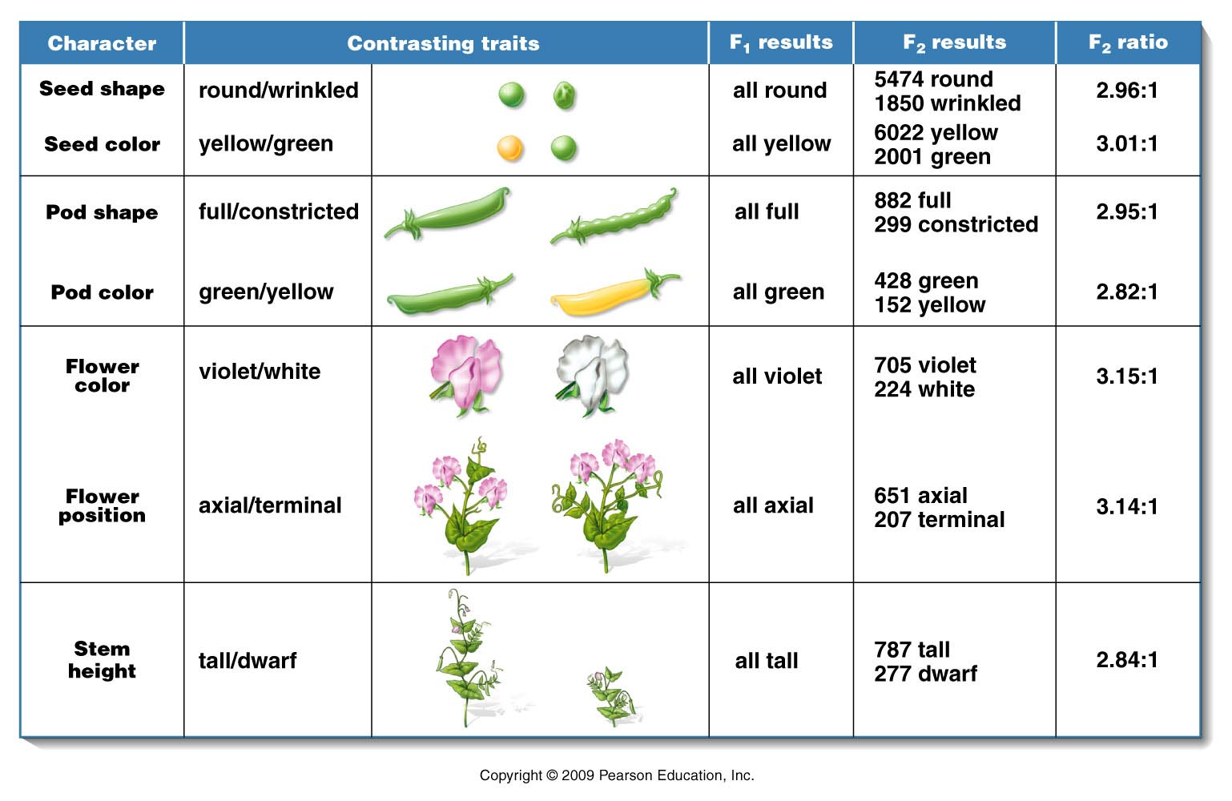
Mendel described 7 traits (phenotypes) of P. sativum which showed clear contrasting forms
Figure 3.1
Notes:
Figure 3-1 A summary of the seven pairs of contrasting traits and the results of Mendel’s seven monohybrid crosses of the garden pea (Pisum sativum). In each case, pollen derived from plants exhibiting one trait was used to fertilize the ova of plants exhibiting the other trait. In the F¹ generation, one of the two traits (dominant) was exhibited by all plants. The contrasting trait (recessive) then reappeared in approximately one-fourth of the F² plants.

Slide 5
Mendel’s experimental approach/terminology
On white board

Slide 6
Outcome of Mendel’s one-trait (monohybrid) crosses
Figure 3.1
Notes:
Figure 3-1 A summary of the seven pairs of contrasting traits and the results of Mendel’s seven monohybrid crosses of the garden pea (Pisum sativum). In each case, pollen derived from plants exhibiting one trait was used to fertilize the ova of plants exhibiting the other trait. In the F¹ generation, one of the two traits (dominant) was exhibited by all plants. The contrasting trait (recessive) then reappeared in approximately one-fourth of the F² plants.

Slide 7
Initial observations (see table)
F1 generation had the phenotype of only one of the parents
F2 --the other parent’s phenotype showed up, but in only 1/4th of the offspring
Results of reciprocal crosses were identical (male X female)= (female X male)
*Mendel began to describe an inheritance particle that is passed from parents to offspring—unit factor

Slide 8
Principals/postulates derived from Mendel’s monohybrid crosses
Genetic traits/phenotypes are controlled by unit factors which exist in pairs in individual organisms.
When 2 unlike unit factors are present in an individual one is dominant to the other, which is called recessive.
During formation of gametes, the pairs of unit factors segregate randomly such that each gamete receives one or the other. (pairs of unit factors are restored in the union of gametes/production of offspring

Slide 9
What is a cross--really?
P X P or F1 X F1
----What is the “X”?
Plants (or whatever organism you study) having sex. The fertilization of eggs from female, with sperm from male.

Slide 10
Many plants are hermaphrodites--- having both types of sexual equipment on one plant/flower.
Self fertilization is the norm. That means, male and female gametes form using chromosomes from one genome combine to make the new generation.
Pollinators, wind, chance, allows pollen/sperm to travel to ovum on the same plant.

Slide 11
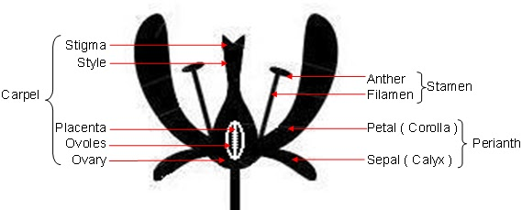

Slide 12
Male/sperm producing
Female/egg producing

Slide 13
Outcrossing/cross pollination occurs as well---via wind, pollinators. When one plant’s pollen fertilizes a different plant’s ovum.
Note how the anthers are located below the stigma. Any ideas why that arrangement might be favored?

Slide 14
How exactly did Mendel manage to control sex in pea plants?!
Self-pollenating
Cross-pollenating

Slide 15
By protecting the female part from fertilization with it’s own pollen, it can be pollinated with a different plant’s pollen.
Mendel chose plants with contrasting forms of the same trait---Plants with white flowers crossed with plants with violet flowers….for example. He created hybrids—hybrids with one contrasting trait are called monohybrids.

Slide 16
Each pea (seed) is a the product of a unique fertilization event. Peas are the offspring of the cross
The pod is the ovary of the plant
Each seed holds the developmental program for a new pea plant.

Slide 17
The fertilized plant, produces seeds from the ovary. The seeds can be directly examined or planted to see what the characteristics of the new generation plant will be.
With seven different traits, Mendel saw the same pattern…and formed a set of hypotheses...

Slide 18
Principals/postulates derived from Mendel’s monohybrid crosses
Genetic traits/phenotypes are controlled by unit factors which exist in pairs in individual organisms.
When 2 unlike unit factors are present in an individual one is dominant to the other, which is called recessive.
During formation of gametes, the pairs of unit factors segregate randomly such that each gamete receives one or the other. (pairs of unit factors are restored in the union of gametes/production of offspring

Slide 19
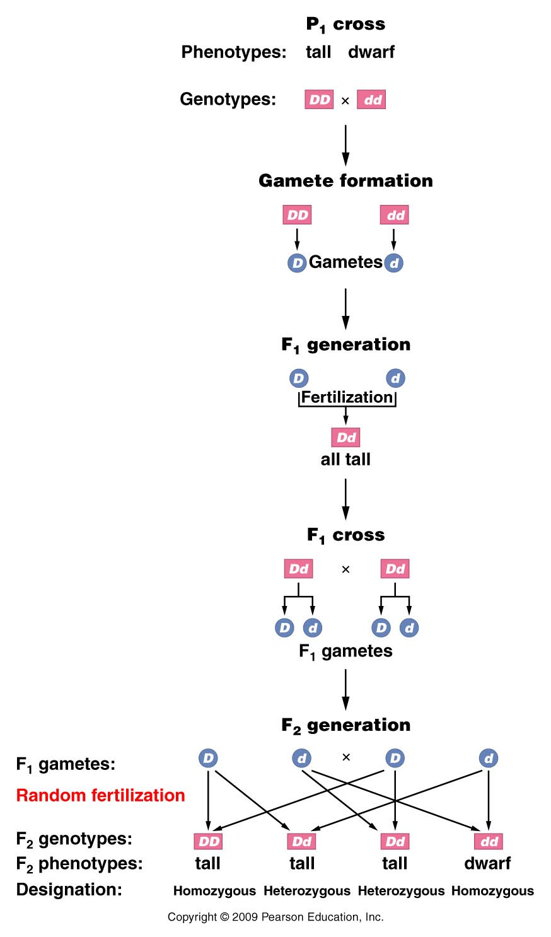
Apply the postulates to one of Mendel’s monohybrid crosses.
Unit factor symbol=D/d
(usually based on the recessive trait, in this example “dwarf” (not tall)
Figure 3.2
Notes:
Figure 3-2 The monohybrid cross between tall and dwarf pea plants. The symbols D and d designate the tall and dwarf unit factors, respectively, in the genotypes of mature plants and gametes. All individuals are shown in rectangles, and gametes are shown in circles.

Slide 20
More terms
Genotype= combination of unit factors present in an individual
Homozygous/homozygote=having like unit factors
Heterozygous/heterozygote=having unlike unit factors (In a heterozygote the dominant factor is expressed; the recessive factor is not.

Slide 21
Postulate 3 is the most important…It describes gamete production--meiosis
During formation of gametes, the pairs of unit factors segregate randomly such that each gamete receives one or the other. (pairs of unit factors are restored in the union of gametes/production of offspring

Slide 22
Useful tool for tracking unit factors and combinations in offspring
Punnett square---designed by Reginald C. Punnett
male
gamete
gamete
female
cojkldjflkdjfjdflkjdflkj
gamete
Zygote/offspring
Zygote/offspring
gamete
Zygote/offspring
Zygote/offspring

Slide 23
Tall X dwarf-F1 cross
F1 X F1= Dd X Dd
D
d
cojkldjflkdjfjdfljdflkj
D
DD
dD
Dd
d
dd

Slide 24
Figure 3.3
Notes:
Figure 3-3 The use of a Punnett square in generating the F² ratio from the cross shown in Figure 3–2.

Slide 25
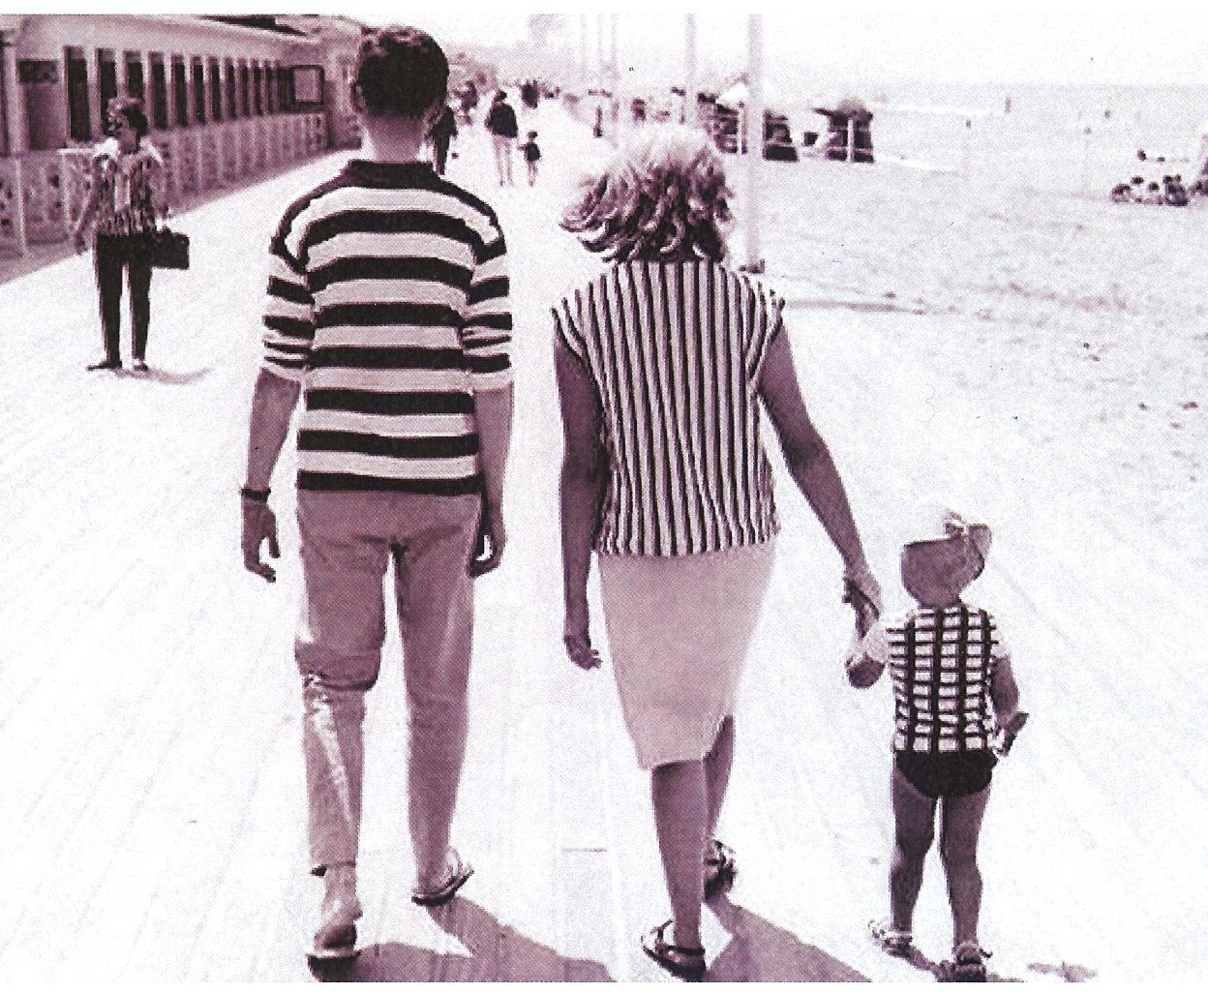
Remember this couple? Does the offspring fit Mendel’s observations?
☺

Slide 26
What were Mendel’s “unit factors”?
They sound like behavior of homologous chromosomes!
Now know they are genes---different alleles of genes located on homologous chromosomes.
D/d are alleles of a gene that controls how tall the plant gets.

Slide 27
What is a gene?
A DNA unit which exerts its effect through RNA or protein.
Alleles of one gene would encode the same RNA or protein, but different alleles differ (to different degrees) such that the RNA or protein potentially function differently.

Slide 28
Example?
We saw that sickle cell anemia is caused by a change in one gene—the gene that encodes one (β-globin) of the proteins making up our hemoglobin in red blood cells.

Slide 29
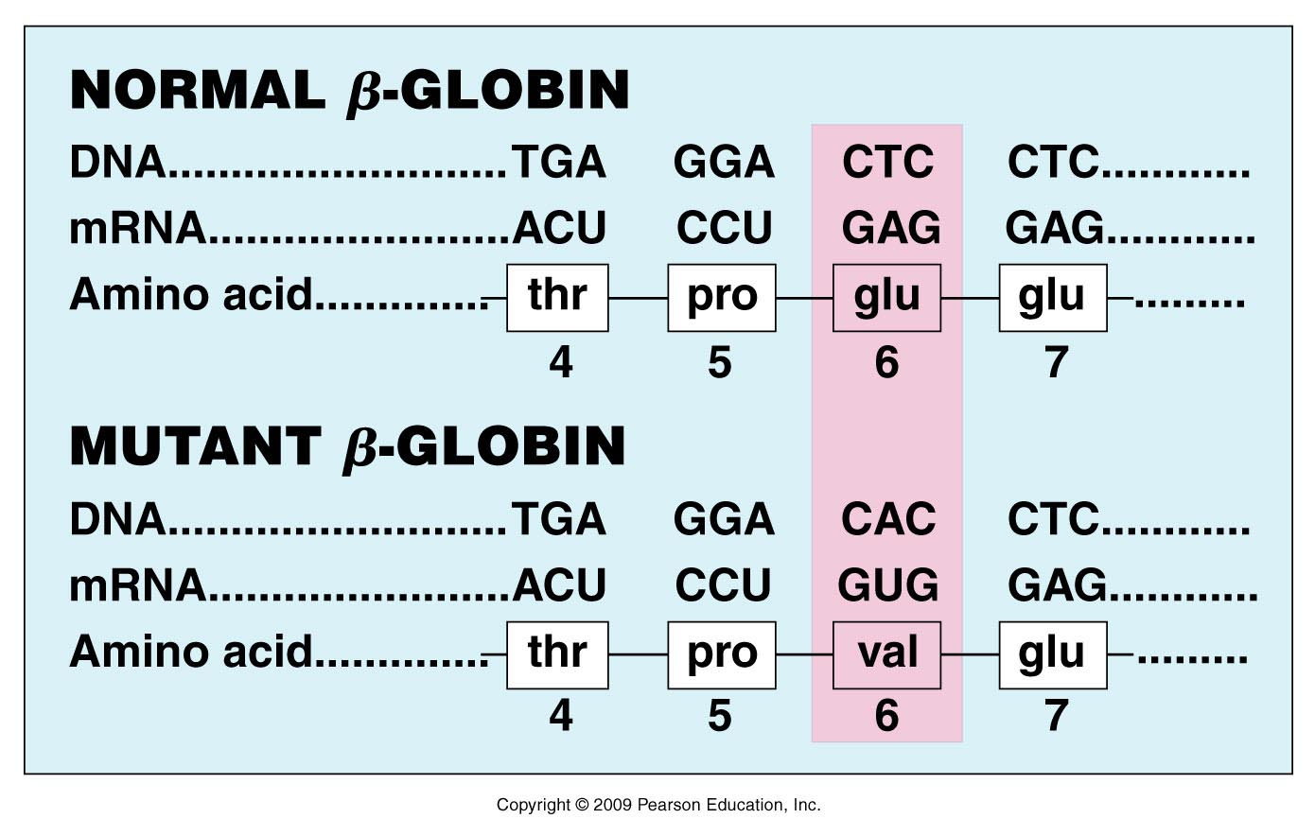
Here are 2 alleles for β-globin that have been identified in the human population. The difference is a single nucleotide letter at a specific position in the gene.
Figure 1.12
Notes:
Figure 1-12 A single nucleotide change in the DNA encoding the β-globin gene (CTC → CAC) leads to an altered mRNA codon (GAG → GUG) and the insertion of a different amino acid (glu → val), producing an altered version of the β-globin protein, causing sickle cell anemia.

Slide 30
All people have 2 alleles for β-globin (one from mother, one from father). Most of us have 2 “good” alleles.
Some people inherit 2 mutant alleles (one from mother, one from father) and develop the sickle cell phenotype.

Slide 31
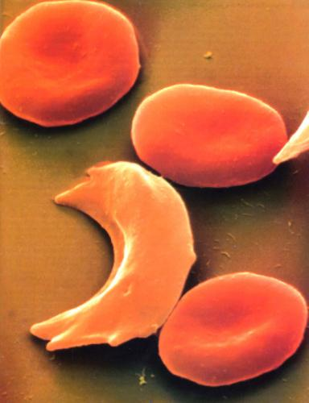

Slide 32
Let’s stay with the phenotype of plant height…
How do the different genotypes explain the phenotype? Recall how genes work…
gene RNA (protein) effect/trait/characteristic
What might “D-gene” encode?
Growth protein? D=allele encodes functional protein
d= allele non-functional/absent

Slide 33
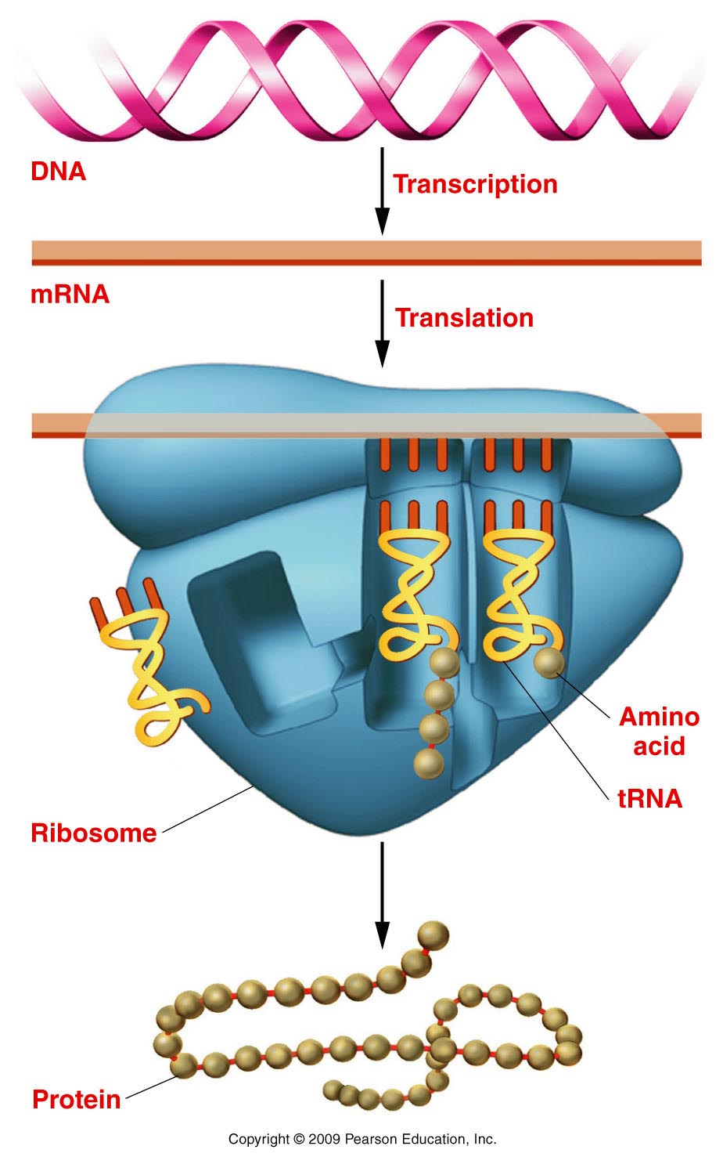
Growth gene
D or d allele
The Central Dogma of Biology
Growth protein D
or d (non functional)
Proteins
Figure 1.9
Notes:
Figure 1-9 Gene expression involves transcription of DNA into mRNA (top) and the translation (center) of mRNA on a ribosome into a protein (bottom).

Slide 34
See other examples…
P.49---A molecular explanation for white flowers (rather than purple) on garden pea plants.
P. 61 explains---at the molecular level, how Mendels peas became wrinkled.
Read, re-read, write /draw it out! (using symbols and the central dogma)

Slide 35
Mendel’s idea of dominance poses a potential problem…
What is the genotype of an organisms with the dominant phenotype?
e.g. Tall pea plants?
DD or Dd?

Slide 36
Mendel developed a specific breeding experiment to test:
Called a test cross:
test organism X homozygous recessive organism
(organism with dominant trait, unknown genotype.)
Tall plant X dwarf plant
(D ? X dd)
Only 2 possible outcomes:
DD X dd 100% Dd (all tall/dominant trait)
Dd X dd 50% tall : 50 % dwarf (recessive trait)

Slide 37
Be sure to distinguish between a standard Mendelian cross, and a test cross. They are used to answer different questions!
Review and practice all the concepts from todays lecture. Compare them to what you’ve learned about meiosis. Honestly—if you master the concepts from today’s lecture, you will have the foundation for most the rest of the course.

